Slide 1
The Challenge of Community
Enterprise risk assessment: A balance
Enterprise objectives
Risks to those objectives
Costs of security measures
The ownership problem
Custodians of assets aren't really their owners
The owner is the enterprise
Custodians may suffer less from a loss
Culture of good security practice starts at top

Slide 2
Reputation: Speaking With One Voice
An enterprise must control the information it provides:
Formally identify official company statements
Repudiate unofficial statements
Binding contracts, opinions on products
Employees clarify they are not speaking for company or push them to not speak at all

Slide 3
Companies Also Keep Secrets
Types of company secrets
Obligations – data legally or contractually obliged to keep secret (personnel, SEC, etc.)
Trade secrets
Managing publicity
Secrecy culture
Accountability – officials are held responsible for the information under their control
Need-to-know – some information is only shared if the recipient specifically needs it
NDA

Slide 4
Enterprise Risks
Disclosure: Theft of trade secrets; privacy breach; insider trading
Masquerade: Fraud*; social engineering
Subversion: More fraud (insider); rootkits; network subversion
Service loss: Extortion; vandalism; logic bombs
Physical theft: Equipment theft; laptop theft, storage/backups

Slide 5
Insiders versus Outsiders
Outsiders are always considered a threat
Outsiders don't share enterprise objectives, like employees or other insiders
Insiders may be a threat
Fraud and theft is often performed by insiders
Easier access
Extorted/enticed from outsider
Quasi insiders
Malicious/non-malicous

Slide 6
Reducing Insider Threat
Malicious
Least privilege
Monitoring/logging
Physical access
Multi-person control: Separation of Duty
Job rotation: Makes it hard to reliably “cook the books” to keep fraud hidden
Pay attention to employee satisfaction/HR
Hiring process

Slide 7
Reducing Insider Threat
Non-malicious
Shadow IT
Cybersecurity as an organizational goal
Regular meetings with department heads and other employees
Bug bounty
Security awareness training with personal cyber-hygiene

Slide 8
Social Engineering
Techniques to attack an organization, usually by posing as an insider
Most insiders will try to help another insider
Example: Retrieve a password via Helpdesk
Thwarting social engineering
Identification cards on employees
Security awareness training
Require authentication of important actions
All critical activities must follow procedures that ensure reliable authentication, with no exceptions

Slide 9
Management Processes
Special processes are required when managing large groups of people
Security systems often use these techniques
Written policies and procedures
Delegation through a management hierarchy
Auditing and review

Slide 10
Written Policies and Procedures
Two types of policies
Policy specification – security requirements
Policy directive – a collection of rules or other guidance distributed to others to direct their actions, aka policies and procedures
Most “security policies” are policy directives
Acceptable use policies (AUPs)
Policies on software update management
Policies on asset protection, new users, etc.

Slide 11
Security Management Standards
Standards on how to manage security in an enterprise – the organization's ISMS
Information security management system
International Standard ISO 27000 series
27001 – how to operate and monitor the ISMS
27002 – Code of Practice
Guidelines and recommendations for security measures to use
ISO 27001 Certification – independent validation that an enterprise complies with the standard
Minimum

Slide 12
Standards for Deployment
How does an enterprise deploy a new system?
Get security involved early (baked in rather than bolted on)
Typical phases
Planning: Establish requirements, risks
Implementation: Design and build
Deployment: Approve and install
Risk acceptance – an executive decision that the system's benefits outweigh its risks

Slide 13
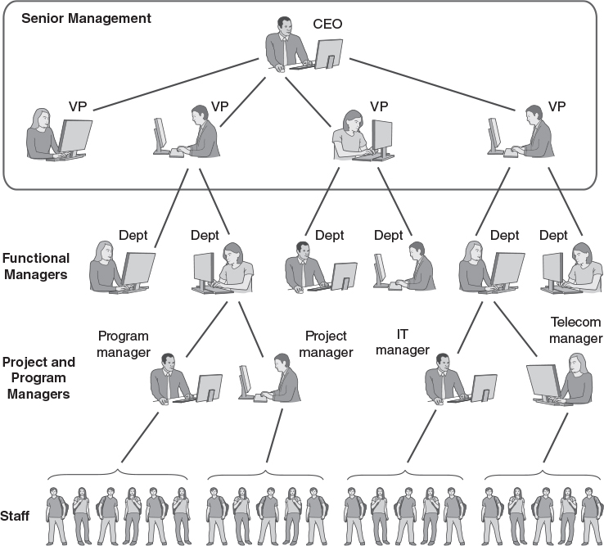
Management Hierarchies
Jones & Bartlett Learning

Slide 14
Profit and Cost Centers
A profit center is a division of the enterprise that brings in money
A division that builds and sells a product, or gets paid to perform a service
A cost center is a division that costs money
Often an administrative support activity
IT departments are often cost centers
It's easier to spend money on security if the expense helps set up a profit center
Deploying SSL in the 1990s for e-commerce

Slide 15
Security Audits
Compliance audits – verify that security complies with an external standard
ISO 27001, PCI DSS, etc.
Requires review by external auditor
Internal security reviews – internally driven security assessments
Review compliance with established policies
Vulnerability scan or penetration test
Audit log reviews to seek unexpected activities or to investigate an incident

Slide 16
Personnel Security
Employee clearances: Background investigations for trusted employees
Employee life cycle: How to bring on a new employee, and how to terminate employee access
Employee roles
Different roles have different access rights
Administrators and Separation of Duty
Partial insiders: consultants, volunteers, etc.

Slide 17
Physical Security
Power management
Power control protection; UPS; alarms
Information system protection
Physical protection of systems and links
Hardware failure recovery
Disaster recovery
Environmental management – HVAC

Slide 18
Software Security
Software development security
Revision control
Configuration management
Baked-in
Formalized coding activities
Coding standards, reviews, analysis
Avoiding risky practices
Unsafe functions, input validation, consistent data formats, error checking, monitoring
Software-based access control: Labels, encryption, integrity checking

Slide 19
Contingency Planning
Preparation for serious incidents or disruptions
Serious attacks on computer systems
Fires, floods, tornadoes, etc.
Types of contingency planning
Business Continuity
Data backup and recovery (DR)
Incident handling
Disaster preparation and recovery

Slide 20
Data Backup and Recovery
Full versus partial backups
Incremental
Cumulative Differential
Types of backups
File-level
Full-image/block level
RAID – not really a backup

Slide 21
Backup Strategy
Decide what to back up
Everything, or only active files?
Decide when and how to back up
More often = more intrusive and expensive
Less often = misses more recent work
Verify that the system works
Attempt a system restoration
Arranging on-site and off-site backups
A major disaster may destroy on-site backups

Slide 22
Incident Handling
A serious attack has four phases
Surveillance
Infiltration
Execution
Disengagement
Attack may be detected in any phase
Establish time lines
Establish an incident handling policy
Ensures that incidents are handled effectively

Slide 23
Incident Handling Policy: Elements
How to grade incidents by seriousness
Who to contact in IT and the security organization when incidents occur
What technical steps to take to mitigate damage
How to report the incident to other departments and to senior management
Which incidents to report to law enforcement

Slide 24
Disaster Preparation and Recovery
Two major planning activities
Business Impact Analysis (BIA)
Estimates the impact of worst-case scenarios on business activities
Helps identify critical business activities
Business Continuity Plan (BCP)
Develop plans to restore critical business activities after a disruption

Slide 25
Business Impact Analysis
Make a list of major business units
Within each unit, identify business processes
For each process, assess the following:
Dependence on IT for operation
IT elements required, and interdependencies with other processes
Impact on business if the process doesn't occur for 1 hour, 1 day, 1 week, 1 month, etc.
Using this information identify requirements for recovery

Slide 26
Recovery Strategies
Delayed recovery
Low up-front expense; high disruption
Start recovery after the event: replace equipment, install, restore from backups, etc.
Cold standby
Implement a separate site that provides idle equipment to use for the recovery
Hot standby
Implement a separate, continuously operating site that can take over from a damaged site

Slide 27
Business Continuity Plan
Identify critical business tasks: Refer to the BIA
Identify enterprise officials who can approve a continuity plan
Establish backup requirements for all critical business tasks
Develop procedures to resume critical activities off-site after a disaster
Develop a strategy to transition back from off-site operations to routine operations after the primary site has recovered

Slide 28
Information Resource Management
An enterprise may centralize, distribute its IT and resource management, or a mix
Centralized IT management
May appoint a CIO; operate a cost center
Economies of scale; interoperability
Charge back
Distributed IT management
Distributes cost among divisions
Allows tailored IT
Security management can follow the IT management structure

Slide 29
Information Security Professionals
Typical roles
Management: CISO, department managers
Analysts, implementers (IT), and testers (QA)
Auditors, forensic investigators
Training
Product-specific – Cisco, Microsoft, etc.
Hands-on – day-long, week-long courses
College – 2- or 4-year programs
Certification: Product specific, hands-on, or professional (CISSP/CISA, etc.)

Slide 30
Careers/Jobs
https://www.sans.org/cybersecurity-careers/20-coolest-cyber-security-careers/
https://www.cyberseek.org/pathway.html
https://niccs.cisa.gov/workforce-development/cyber-security-workforce-framework
https://twitter.com

